Slide 1
Classifying Images Post Hurricane using Satellite Imagery
By Prathyush P Rao, M.K. Vishal Rishi, Saili Myana, and Sai Sumanth Madicherla

Slide 2
The problem we chose:
Problem statement
Context
The problem
Classifying buildings post Hurricane using Satellite Imagery and Deep learning techniques
Damage assessment is vital to helpers and relief workers, post hurricane attack
It allows resources to be allocated efficiently
This process is manual and hence, laborious
Hence, there arises a need to classify damaged and non-damaged buildings efficiently and quickly

Slide 3
Our approach to find a deep learning solution!
Step 1
Step 2
Step 3
Gather and explore data!
Our dataset comprised satellite images from "Geo-satellite sensor" and "Geo Bigdata".
Consists of 128x128 top view images of damaged and undamaged houses.
Train, test and interpret!
After training, we evaluated the model on the hold out sets.
Reconstructions were used to increase the CNN’s interpretability.
Further enhancements!
We tried to understand research articles that address this issue.
Transfer learning can improve efficiency
Test the model on Hurricane Delta

Slide 4
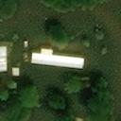
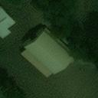
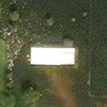
Describing the data
Sample images from the dataset. Each image contains three channels (RGB) with dimensions 128x128
Train set: 5000 images in each class with data augmentation
Validation set: 1000 images in each class
Test set 1: 8000 images in ‘damaged’ and 1000 images in ‘undamaged’
Test set 2: 1000 images in each class

Slide 5
A peek into the algorithm
DenseNet 201
(include_top = False)
Dense layer (512 neurons)
Activation = Relu
Sigmoid layer
(1 neuron)
Libraries used:
Tensorflow
Numpy, Pandas, and Matplotlib
OpenCV
Tf_keras_vis
Seaborn

Slide 6
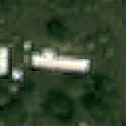
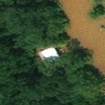
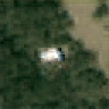
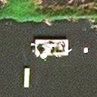
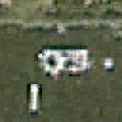
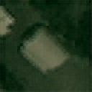
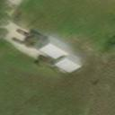
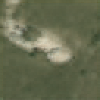
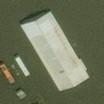
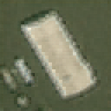
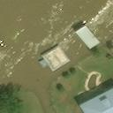
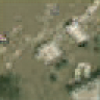
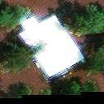
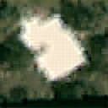
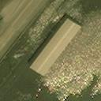
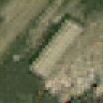
Transpose convolutions as visualisations!
(Original image on the left and the reconstructed image on the right of each column)

Slide 7
Result
The model’s quality was measured with both true accuracy and Area Under the ROC Curve (AUROC which captures the trade-off between the model’s true positive and false positive rates of detection - a helpful tactic when it useful to have more false positives than false negatives.
According to crisis responder feedback, 70% accuracy is the threshold for making high-level decisions in the first 72 hours after the disaster
Category | Accuracy | AUROC
test_another | 96.2% | 94.6%
test | 93.4% | 93.9%
validation | 93.5% | -

Slide 8
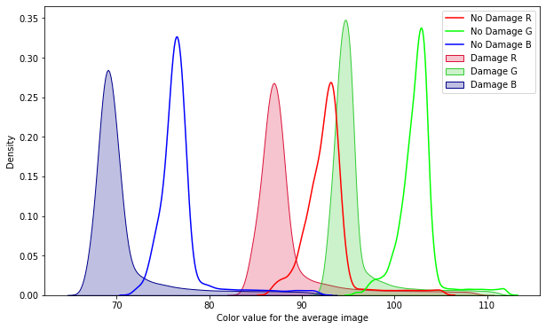
RGB kde plot

Slide 9
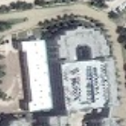
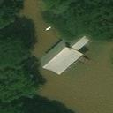
Future work
Hurricane Harvey (2017)
Hurricane Iota (2020)
Generalize to different geographies
Accurately assess damage around the globe
A system that interacts with local support and expert analysts
Building localization

